Slide 1


GO Team
W. J. Scott ElementaryBusiness Meeting #2
Where we are – Where we’re going
One District. One Goal. Every Child.

Slide 2

Agenda
Call to Order
Roll Call; Establish Quorum
Action Items
Approval of Agenda
Approval of Previous Minutes
Discussion Items
Graduation Rate (For High School GO Teams if not previously discussed)
2025-2030 Strategic Plan Development
Information Items
Principal’s Report
APS Forward 2040 –Comprehensive Long-Range Facilities Plan Update
Announcements
Public Comment
Adjournment

Slide 3

Action Items
Approval of Agenda
Approval of Previous Minutes

Slide 4
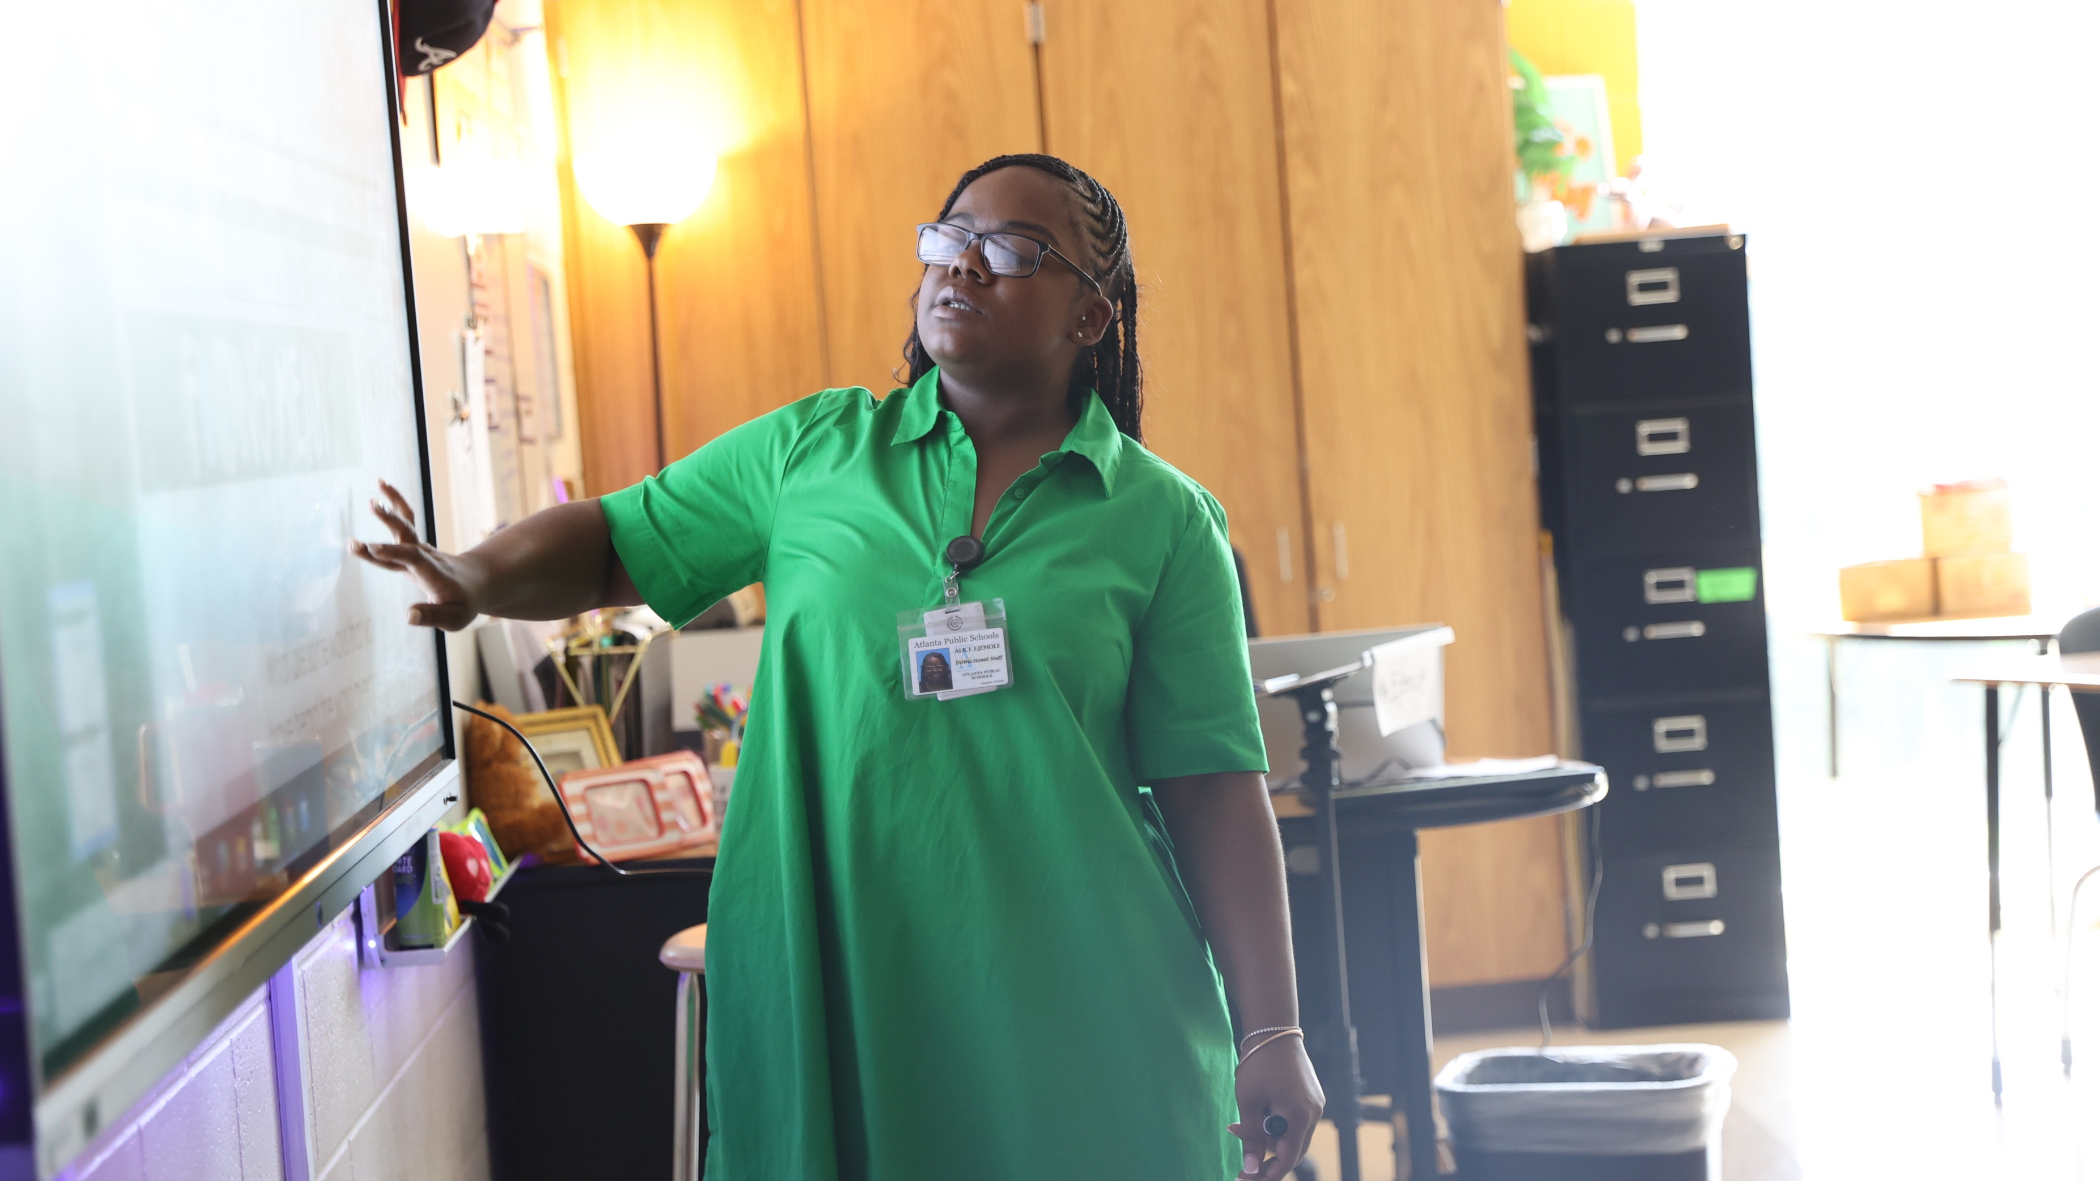

Discussion Items
One District. One Goal. Every Child.

Slide 5

Graduation Rate
For HS GO Teams- If information has not been presented at a previous GO Team meeting
Before Presenting to your GO Team:
Insert School’s 2025 Graduation Rate – use as many slides as necessary
Discuss the information with the GO Team during your meeting.

Slide 6
2025-2030 School Strategic Plan Development

Slide 7


Atlanta Public Schools
2025-2030 Strategic Plan
One District. One Goal. Every Child.

Slide 8


We are Atlanta’s Public School System
To educate and empower Atlanta’s students to shape the future

Slide 9

A COMMUNITY OF BELIEVERS GETTING BACK TO BASICS
Our Strength is Our Team
Atlanta’s students will have effective and engaged teachers, leaders, and staff.
Increase concentration of highly-effective teachers and leaders
Prioritize engagement and retention for staff
Grow and promote strong teachers, leaders, and staff
Our Responsibility Is Shared
Atlanta’s students will have supportive families, communities, and partners.
Build meaningful partnerships
Expand Atlanta Partners for Education (APFE) impact
Increase access and engagement for families and communities
Our System Is Efficient & Effective
Atlanta’s students will have the schools and resources they need to succeed.
Maximize facility usage for the student and community good
Leverage data to drive strategic financial investments
Implement sustainability initiatives
We Are Strengthening Our Instructional Core
Atlanta’s students will have high-quality instruction, materials, and targeted support.
Implement high-quality, relevant, and engaging instructional materials and professional learning in all core content areas
Target resources towards subgroups (eg. exceptional education, English learners, economically-disadvantaged)
Accelerate early learning
We Are Caring For Every Child
Atlanta’s students will have trusted, supportive adults meeting their unique needs.
Expand strategies that reduce chronic absenteeism and disproportionate discipline
Implement systematic culture and climate strategies
Increase student access to trusted and reliable adults (eg. mentors, coaches, counselors)
We Are Sparking Student Curiosity
Atlanta’s students will have access to explore and expand their passions and interests.
Promote robust arts, athletics, world language, and enrichment offerings
Expand access to high-interest and workforce-ready offerings (e.g. career programs and pathways, advanced coursework)
Explore specialized and innovative school models (eg. School of the Arts)

Slide 10
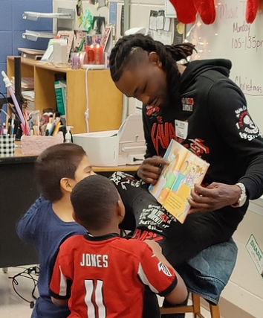
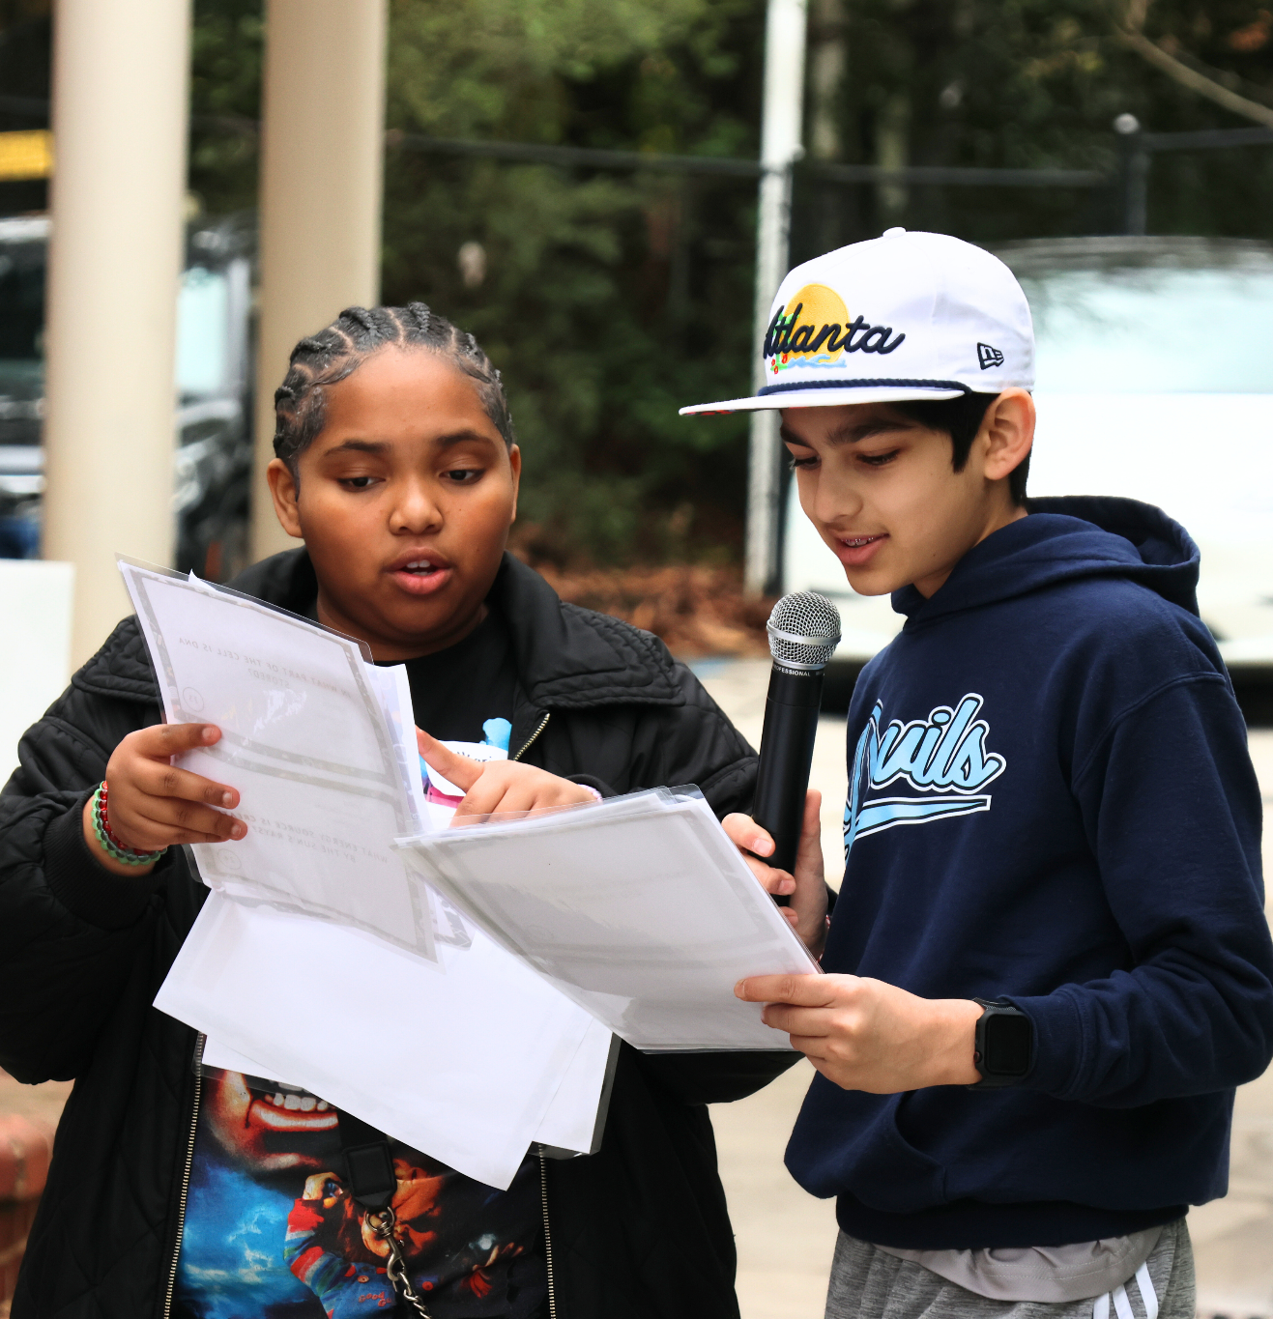

Goals and Key Performance Indicators
Focus Area:
We Are Caring For Every Child
1
By 2030, we will increase the percentage of 3rd grade students scoring proficient or above in ELA (GA Milestones) by 20 percentage points.
Actual (2025)
Light pink: 2024
Target (2030)
68.8% | Absenteeism % of students who are not chronically absent* | 80%
60% | Sense of Belonging % students who feel a sense of belonging* | 75%
89.6% | Discipline: All Students % of all students without suspensions (OSS) * | 95%
83.5% | Discipline: Students with Disabilities % of Students with Disabilities students without suspensions (OSS)* | 95%
86.4% | Discipline: Black Students % of Black students without suspensions (OSS)* | 95%
56% | Student-Staff Relationships % of students feeling comfortable going to most or all of the adults in the school for help* | 75%
0% | Student Success Plans % of students with individual success plans | 90%
19% | School Climate % of schools with 4 or 5 star climate rating* | 50%
2
By 2030, we will increase the percentage of 8th grade students scoring proficient or above in Math (GA Milestones) by 20 percentage points.
3
By 2030, we will increase the percentage of students meeting at least one CCRPI College and Career Readiness Indicator by 20 percentage points.
* Includes Charter and Partner Schools

Slide 11
GO Team School Strategic Plan Development
One District. One Goal. Every Child.

Slide 12
Mission
What is our purpose?
What do we do?
We are educating and empowering Atlanta’s students to shape the future.
Vision
What is our picture of the future?
Literacy
Numeracy
College & Career Readiness
Strategic Goals
What results do we want to satisfy our stakeholder needs?
Focus Areas
What are the main focus areas (“Pillars of Excellence”) of our work?
We are Caring for Every Child (example)
Objectives
What continuous improvement activities are needed to get results?
Expand strategies that reduce chronic absenteeism (example)
Governance
Key Performance Indicators
How will we evaluate performance to know if we are achieving the results we want?
% of students who are not chronically absent (example)
Strategies
What high-leverage strategies will lead to the desired results?
Implement Multi-Tiered Systems of Support (MTSS) (example)
Actions
Who will do what by when?
Monthly, provide consistent communication with all families on the importance of attendance and supports available (example)
Management

Slide 13
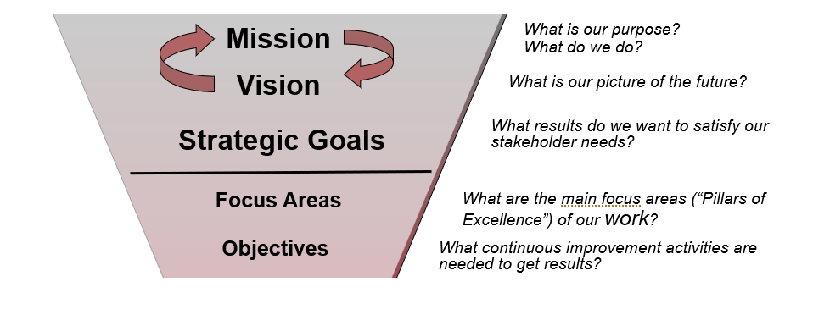
GO Team Focus (Governance)

Slide 14
School Strategic Planning Overview
Purpose
To cascade the district strategic plan to the school level, while grounding our focus in the school’s Continuous Improvement Plan. This will create alignment, reduce confusion, and simplify our efforts.
Timeline
Our school’s 2030 Strategic Goals and Objectives should be updated, approved and ranked by January 2026. Schools will focus on the strategies as part of FY27 Budget and Continuous Improvement Plan processes.

Slide 15
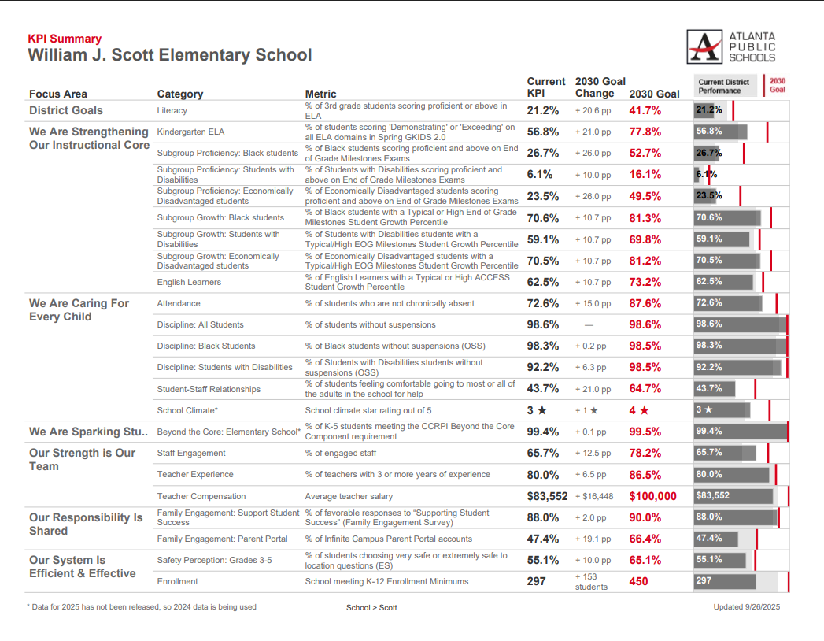
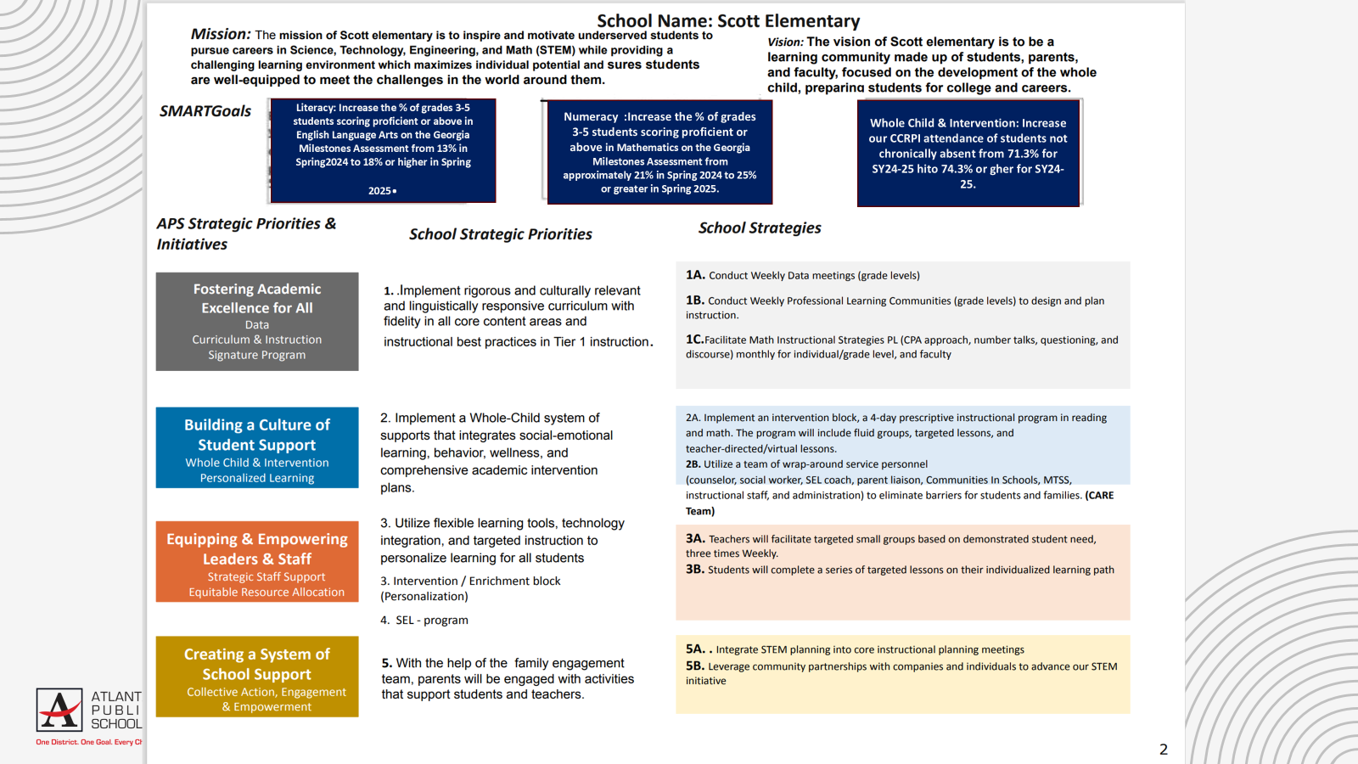
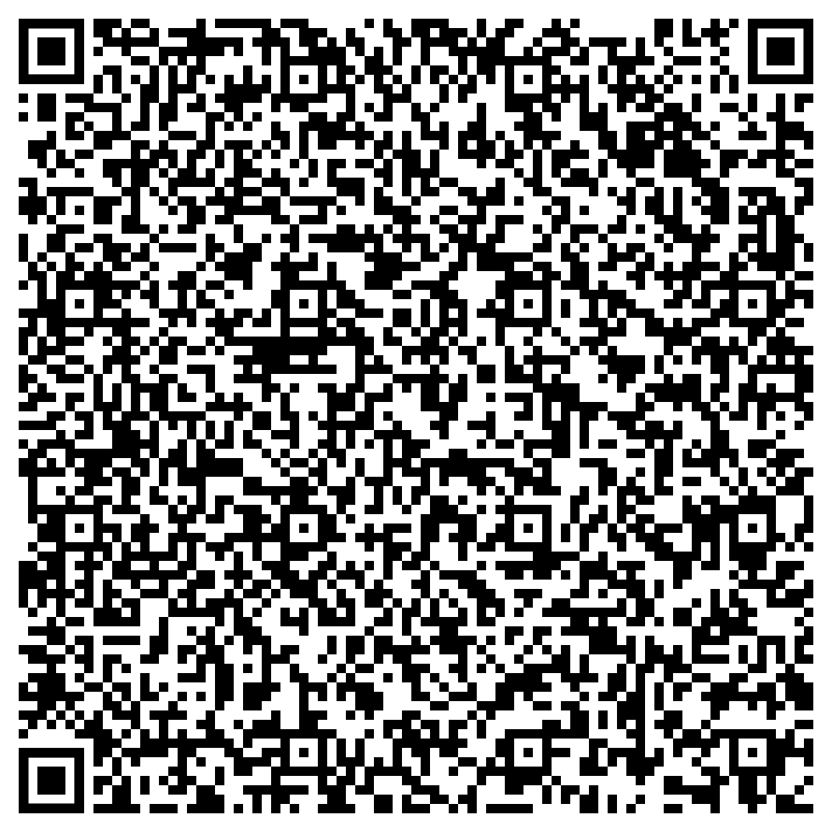
Three Key Resources to Review
1
2020-2025 School Strategic Plan
2
2025-2026 Continuous Improvement Plan Goals
3
School Data Sheet
https://tinyurl.com/SchoolDataSheets
By the end of the 2025 - 2026 school years, Scott will increase the percent of students scoring proficient and above on the GMAS assessments in math by 5%, from 23.5% to 28.5%.
By the end of the 2025 - 2026 school years, Scott will increase the percent of students scoring proficient and above on the GMAS assessments in math by 5%, from 26.8% to 31.8%.
By the end of the 2025 - 2026 school year, Scott will increase the CCRPI Attendance from 74.1% to 77.1%
Use the QR code to access all school data sheets

Slide 16
School Strategic Planning Process
1
Review Data
Sample GO Team Business Meeting Cadence
Business Meeting 1:
Review Data (MAP, GMAS, Graduation Rate, CCRPI, etc.)
Business Meeting 2:
Review Data (School KPIs)
Align Mission/Vision/ Purpose
Confirm 2030 Goals
Business Meeting 3:
Identify 2025-2030 Strategic Objectives
Business Meeting 4 (Budget Allocation):
Confirm & Prioritize Your Strategic Plan
2
Align Mission/Vision/Purpose
3
Confirm 2030 Goals
Create CIP Goals to 2030
Identify Additional Goals
4
Identify 2025-2030 Strategic Objectives
Reflect on 2020-2025 Strategic Plan
Review and Discuss Additional Objectives Going Forward
5
Approve Your Strategic Plan & Rank Your Strategic Objectives for FY27

Slide 17

Today’s Focus:
School Strategic Planning Process: Steps 1, 2, and 3
1
Sample GO Team Business Meeting Cadence
Business Meeting 1:
Review Data (MAP, GMAS, Graduation Rate, CCRPI, etc.)
Business Meeting 2:
Review Data (School KPIs)
Align Mission/Vision/ Purpose
Confirm 2030 Goals
Business Meeting 3:
Identify 2025-2030 Strategic Objectives
Business Meeting 4 (Budget Allocation):
Approve Your Strategic Plan & Rank Your Strategic Objectives for FY27
Review Data
2
Align Mission/Vision/Purpose
3
Confirm 2030 Goals
Create CIP Goals to 2030
Identify Additional Goals
4
Identify 2025-2030 Strategic Objectives
Reflect on 2020-2025 Strategic Plan
Review and Discuss Additional Objectives Going Forward
5
Approve Your Strategic Plan & Rank Your Strategic Objectives for FY27

Slide 18
Review Data
One District. One Goal. Every Child.

Slide 19
Guiding Questions for the GO Team to Discuss:
What do you notice?
What are your wonderings?
Are you on track?
Are there specific sub-group performance gaps?
Outside of the “Instructional Core,” what could be a focus area?
Notes:
Notes:
These are aligned to the district’s KPI’s
Before identifying missing data, review what is available on this dashboard for strategic importance.
Where data from SY25-26 has not been released, data from the prior year is used.
These are great examples of potential additions to your strategic goals.

Slide 20
2. Align Mission/Vision/Purpose
One District. One Goal. Every Child.

Slide 22
Mission and Vision Alignment:
We are Atlanta’s Public School System
To educate and empower Atlanta’s students to shape the future
Guiding Question: Does our current school mission and vision align with these statements?

Slide 23
Proposed Updates to School Mission and Vision:
Mission: The mission of Scott Elementary School is to inspire and motivate underserved students to pursue careers in Science, Technology, Engineering, and Math (STEM) while providing a challenging learning environment which maximizes individual potential and ensures students are well-equipped to meet the challenges in the world around them.
Vision: The vision of Scott Elementary School is to be a learning community made up of students, parents, and faculty, focused on the development of the whole child, preparing students for college and careers.
Mission: Scott Elementary School strives to deliver precise and intentional instruction every day, with high expectations in literacy, rigorous problem solving, and learning experiences aligned with STEAM (Science, Technology, Engineering, Arts/Athletics, & Mathematics), so that our students build the skills, confidence, and agency to make real choices for themselves and their community now and at every stage of their lives.
Vision: Scott Elementary scholars will be empowered thinkers who are literate, curious, capable, and who are prepared to lead, solve problems, and design their own futures with purpose and autonomy.

Slide 24
3. Confirm 2030 Goals
Extend your Continuous Improvement Plan Goals to 2030
Identify if there are any additional goals for the strategic plan beyond those identified. If so, capture them (no more than 1-2 additional goals)
One District. One Goal. Every Child.

Slide 25
Continuous Improvement Goals (Example)
1
By Spring 2026, the percentage of proficient and above learners as assessed by the GMAS EOG ELA will increase by 5% overall from 23.5% (2025) to 28.5%.
2
By Spring 2026, the percentage of proficient and above learners as assessed by the GMAS EOG Math will increase by 5% overall from 26.5% (2025) to 31.5%.
3
By Spring 2026, the CCRPI attendance rate will remain at or above 77%, by ensuring chronic absenteeism as determined by GADOE does not exceed 10% days absent for the student's enrollment period greater than 30 days.
2030 Strategic Plan Goals (Example)
1
By 2030, the percentage of proficient and above learners as assessed by the GMAS EOG ELA will increase overall from 23.5% (2025) to 41.7%.
2
By 2030, the percentage of proficient and above learners as assessed by the GMAS EOG Math will increase overall from 26.5% (2025) to 46.5%.
3
By 2030, the CCRPI attendance rate will remain at or above 87.6%, by ensuring chronic absenteeism as determined by GADOE does not exceed 10% days absent for the student's enrollment period greater than 30 days.

Slide 27
2. Align Mission/Vision/Purpose
One District. One Goal. Every Child.

Slide 28
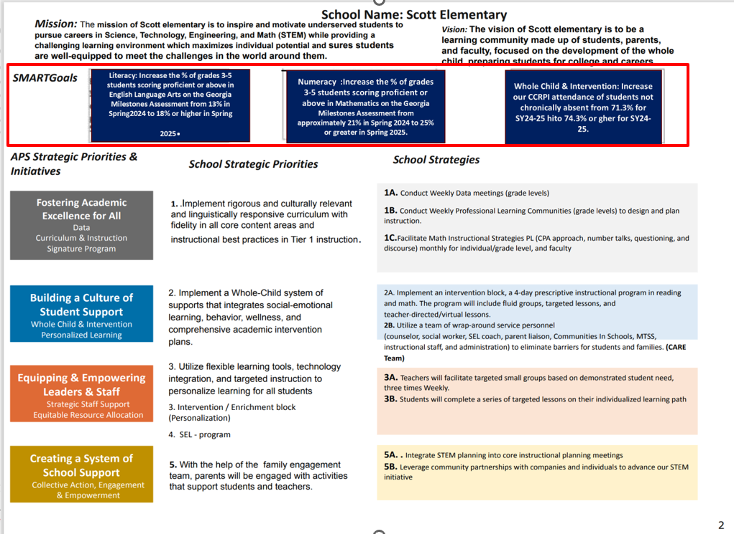
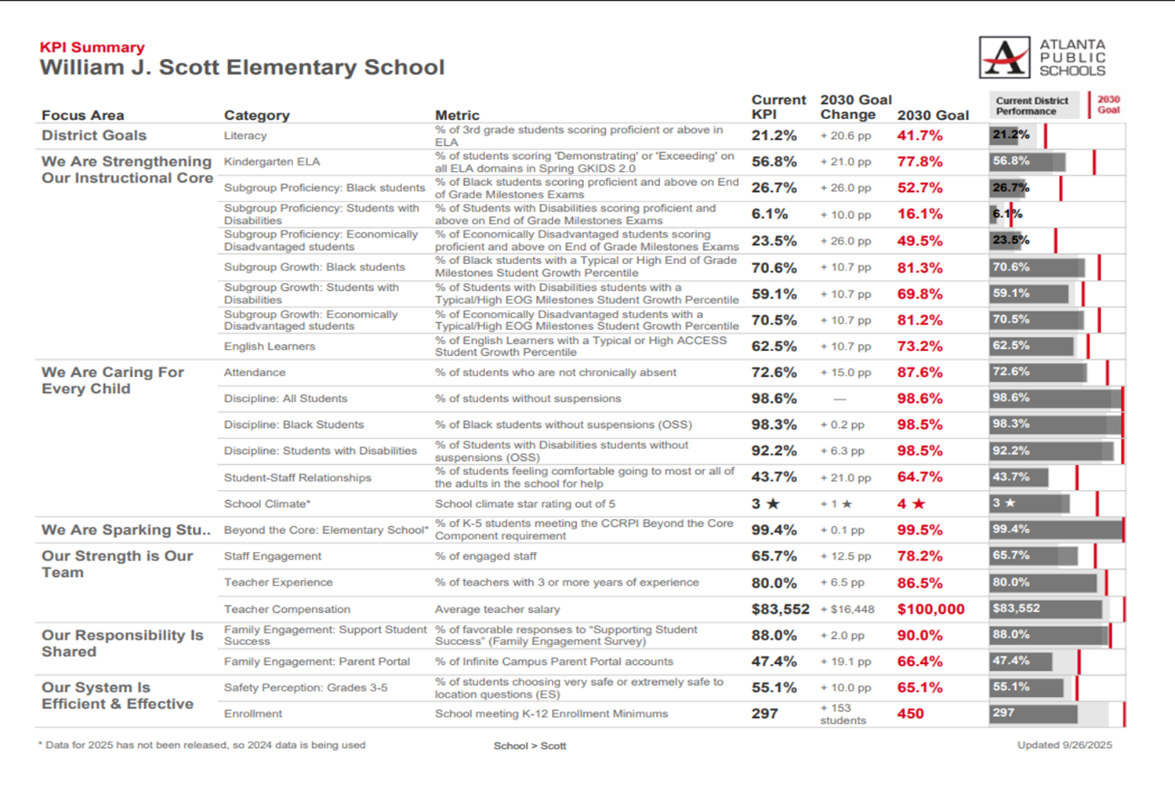
Guiding Question: After reviewing our current Strategic Plan and school KPIs, are there any additional goals we would like to include with our 2030 CIP Goals for the 2025-2030 Strategic Plan? (No more than 1-2 additional goals)
Enter any proposed additional goals for the strategic plan that the team identifies here.

Slide 29
Strategic planning will help you fully uncover your available options, set priorities for them, and define the methods to achieve them.
Robert J. Mckain

Slide 30

Questions?

Slide 31
Principal’s Report
One District. One Goal. Every Child.

Slide 32



APS Forward 2040:
Reshaping the Future of Education
Taskforce Meetings
May 8, 2025 - Presentation
August 5, 2025- Presentation
Upcoming Public Meetings
October 20
November 10
Virtual – at Noon
In-person at 6PM at CLL (130 Trinity Ave)
UPDATE
Comprehensive Long-Range Facilities Plan
atlantapublicschools.us/APS2040
Notes:
Next on our agenda, we’d like to welcome our representative to the Long-Range Comprehensive Facilities Master Plan Taskforce. As many of you know, this taskforce plays a key role in shaping the future of our district’s facilities — ensuring they are aligned with projected enrollment, instructional needs, safety standards, and long-term community use."
Over the summer, the taskforce has been hard at work reviewing data, exploring options, and engaging in important planning conversations. [Name of Representative] will share an update on what’s been done so far, any key decisions or recommendations that have been made, and what’s ahead — including opportunities for the public to provide input.
[Allow the FMP representative to provide an update and answers questions. After this is concluded:]
Thank you [Name of Representative].
A report will be presented to the Board at its August 11 meeting, and the options will become public the week of August 18.
There are several upcoming public meetings where you can learn more and share your thoughts. The next public meetings are scheduled for: August 25, October 20, and November 10
On each date, there will be a virtual meeting at noon and an in-person meeting at the Central Office at 6PM.
I strongly encourage you all to attend these meetings. This is a critical time for public input, and your voice is essential.

Slide 33
Questions?

Slide 34
Thank you

